Slide 1
MODELLING FACTORS ASSOCIATED WITH HIV-FREE SURVIVAL AMONG EXPOSED INFANTS IN HOMA BAY COUNTY
AUGUSTINE GATIMU NJUGUNA
TM 406-3105/2015
Doctor of Philosophy in Epidemiology
14/05/2024
Seminar 3
Professor Simon Karanja
Jomo Kenyatta University of Agriculture & Technology
Late Dr. Peter Wanzala
Institute of Tropical Medicine and Infectious Diseases (ITROMID)

Slide 2
Background
HIV infection is a still a global problem with no cure or vaccine
Pregnant women with HIV face risks of maternal and perinatal morbidity and mortality.
Vertical transmission to fetus during pregnancy, labor, and breastfeeding is still a risk to elimination of the infection.
Progress in reducing pediatric HIV infection through prevention programs has been made.
Challenges in eliminating vertical HIV transmission in Sub-Saharan Africa due to high HIV burden in reproductive-age women

Slide 3
Problem Statement
Despite strategies to prevent mother-to-child transmission of the human immunodeficiency virus (HIV), infected children continue to be born.
Vertical transmission of HIV can be effectively controlled through antenatal screening, antiretroviral treatment and the services provided during and after childbirth for mother and newborn.
World-wide rate of MTCT of HIV is still far from reaching the zero transmission target, even in countries with consolidated screening programmes and standardized protocols of HIV management during pregnancy.
In 2022 Homa Bay County had 4510 mother baby pair Receiving PMTCT services with 8.7 percent of infants getting infected with HIV which implies that more efforts are needed in order to reduce mother to child transmission of HIV.

Slide 4
Problem Statement cont’d
Despite efforts to prevent the transmission of HIV from mothers to their children, new cases of infected infants continue to emerge.
Controlling vertical transmission of HIV requires effective measures such as antenatal screening, antiretroviral treatment, and comprehensive services before and after childbirth for both the mother and newborn.
Globally, the rate of mother-to-child transmission (MTCT) of HIV remains high, even in countries with established screening programs and standardized protocols for managing HIV during pregnancy.
In 2022, Homa Bay County in Kenya had 4510 mother-baby pairs receiving Prevention of Mother-to-Child Transmission (PMTCT) services, with 8.7% of infants becoming infected with HIV.

Slide 5
Problem Statement cont’d
A 2019 study in BMC Public Health estimated that mother-to-child transmission of HIV in Kenya resulted in around 33,000 DALYs that year, emphasizing the significant impact of vertical transmission on the country's disease burden.
Homa Bay County, known for its high HIV prevalence rate, sees a notable number of new infections through vertical transmission, leading to a higher burden of DALYs, especially among HIV-positive children.
The prevalence of HIV among pregnant women in the county is notably high at around 16%, surpassing the national average and increasing the risk of vertical transmission and subsequent DALYs.

Slide 6
Problem Statement cont’d
Infants born with HIV as a result of this transmission face a lifetime of health challenges, leading to a substantial loss of healthy life years.
This not only affects the infected children but also places a strain on healthcare resources and further exacerbates the DALYs in the region.
These findings underscore the urgent need for targeted interventions to prevent mother-to-child transmission and alleviate the burden of disease associated with vertical HIV transmission in Kenya and Homa Bay County.

Slide 7
Justification
Despite progress in reducing infant mortality due to HIV/AIDS, the disease continues to have a devastating impact on infants worldwide.
Factors causing diseases are dispersed unevenly across communities and regions, and the processes that bring people and disease-causing agents into contact vary geographically.
The environment, including physical, social, and economic factors, significantly influences people's health. Geography, particularly the use of geographic information systems, has been instrumental in understanding health-related issues.
Advances in data collection methods, geographic visualization techniques, and modeling have helped identify spatial patterns and disease spread probability.
This study aims to provide insight into the determinants of vertical HIV transmission, filling a critical knowledge gap in the field of epidemiology.

Slide 8
Objectives
Broad objective
To determine factors associated with HIV-free survival among infants born to HIV-positive mothers in Homa Bay County.
Specific Objectives
Determine survival rate of HIV exposed infants in Homa Bay County.
Determine the maternal factors associated with HIV antigen positivity among exposed infants in Homa Bay County.
To determine infant factors associated with HIV antigen positivity among exposed infants in Homa Bay County.
To determine geographical factors associated with HIV antigen positivity among exposed infants in Homa Bay County.
To develop a model on HIV-free survival among infants born to HIV-positive mothers in Homa Bay County.

Slide 9
Conclusion
HIV-free survival among infants born to HIV-positive mothers in Homa Bay County.
Maternal factors associated with HIV antigen positivity
Infant factors associated with HIV antigen positivity
Geographical factors associated with HIV antigen positivity
Demographic and Social-economic factors associated with HIV antigen positivity

Slide 10
Study Design
The research employed a prospective longitudinal cohort design.
The study was conducted among infants born of HIV positive mothers.
Study Area
The study was carried out in Homa Bay County.
The county covers an area of 3,183.3 sq km with a projected in 2023 of about 1,231,659 people.

Slide 11
Sample size determination
The general formula for the required number of subjects in a survival study may be expressed as
Stpower command
stpower cox, power(0.95) hratio(0.37) failprob(0.17) wdprob(0.05)
Estimated number of events and sample size:
E (expected number of events) = 53
N (sample size required) = 326

Slide 12
Data Analysis
Thematic analysis was used to identify, analyze, and report patterns (themes) within the data. This method involved coding and categorizing data to identify themes that encapsulate the meaning of the data
Spatial analysis conducted using conditional autoregressive method with Moran I and Geary Indices.
Spatial scan method used to identify clustering of HIV antigen positivity, spatial autocorrelation method used to establish randomness
Bayesian modeling employed to evaluate spatial factors associated with HIV antigen positivity in Homa-Bay County
R program,QGIS and ARCGIS used for all analyses.

Slide 13
Focused Group Discussion
Understanding of PMTCT
There was varied understanding among participants.
Especially on Importance in preventing mother-to-child transmission of HIV.
Barriers to Accessing PMTCT Services in Homabay County
Stigma associated with HIV.
Lack of awareness about available services in the health facilities.
Long distances to healthcare facilities.
Financial constraints.

Slide 14
Focused Group Discussion cont’d
Male Involvement in PMTCT
Importance of male involvement.
Cultural and social factors hindering male engagement.
Feeding Practices for Infants born to HIV-positive mothers
Emphasis on exclusive breastfeeding and adherence to guidelines.
Challenges in promoting exclusive breastfeeding due to cultural beliefs.
Community Perception of HIV-positive mothers
Stigma and discrimination towards HIV-positive individuals.
Importance of empathy, support, and acceptance within the community for the well-being of HIV-positive mothers and their children

Slide 15
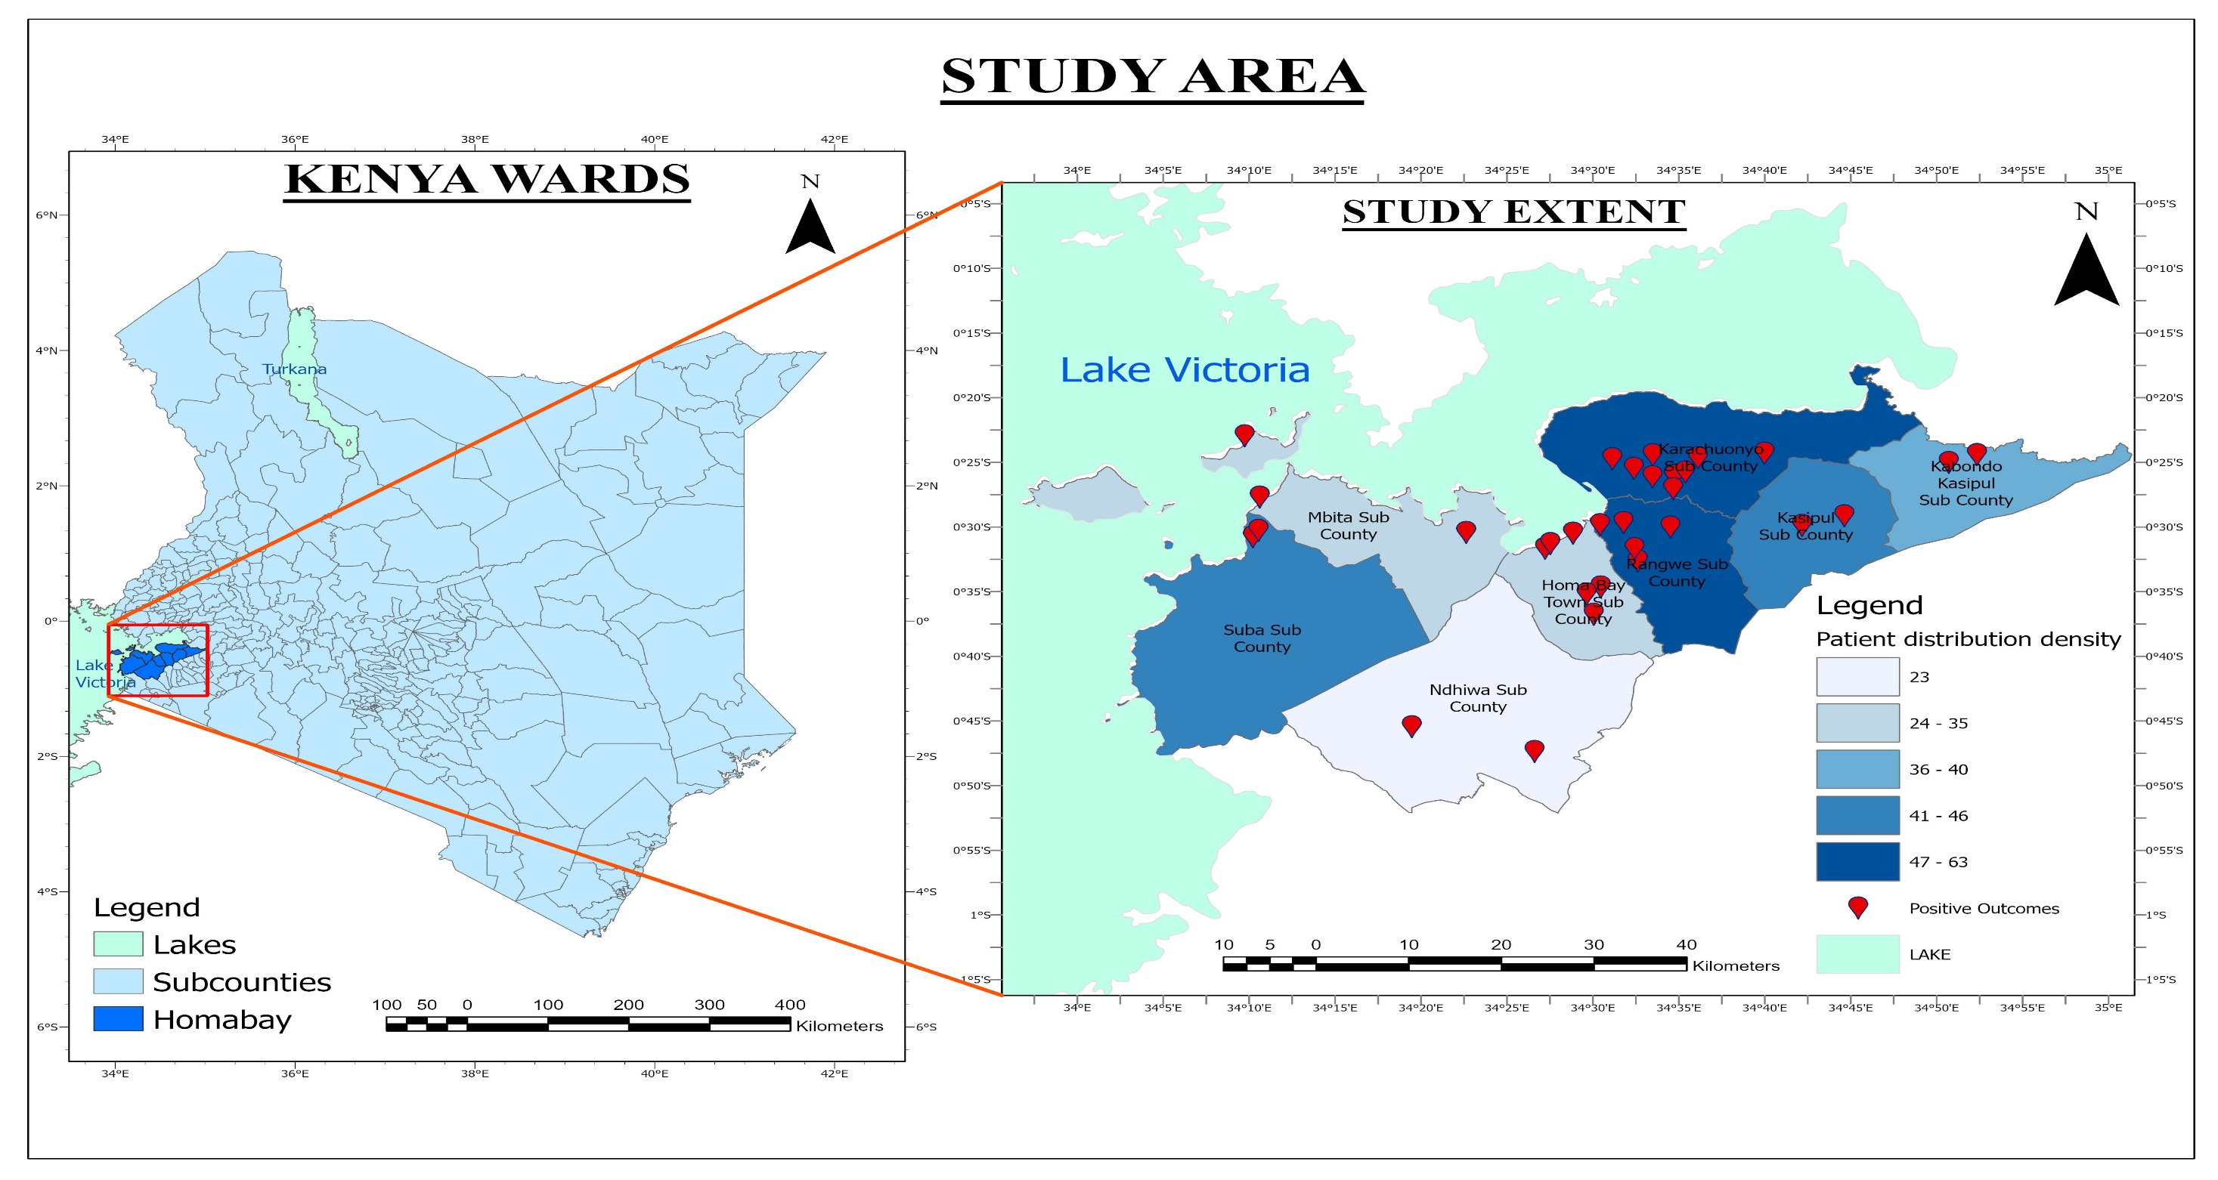

Slide 16
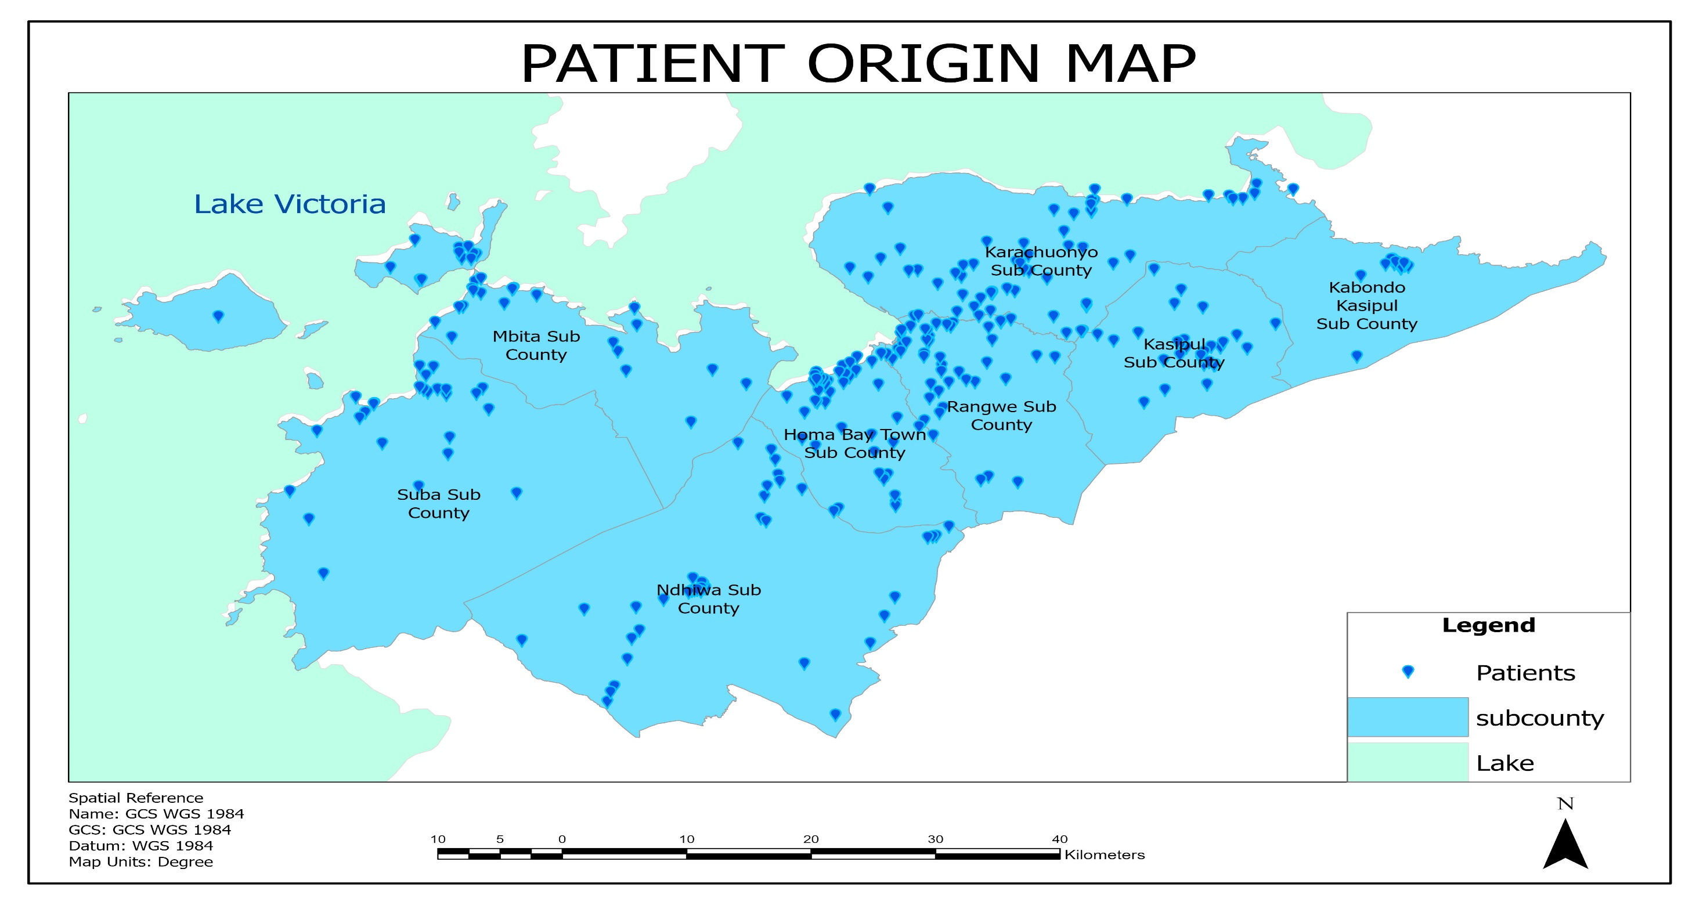

Slide 17
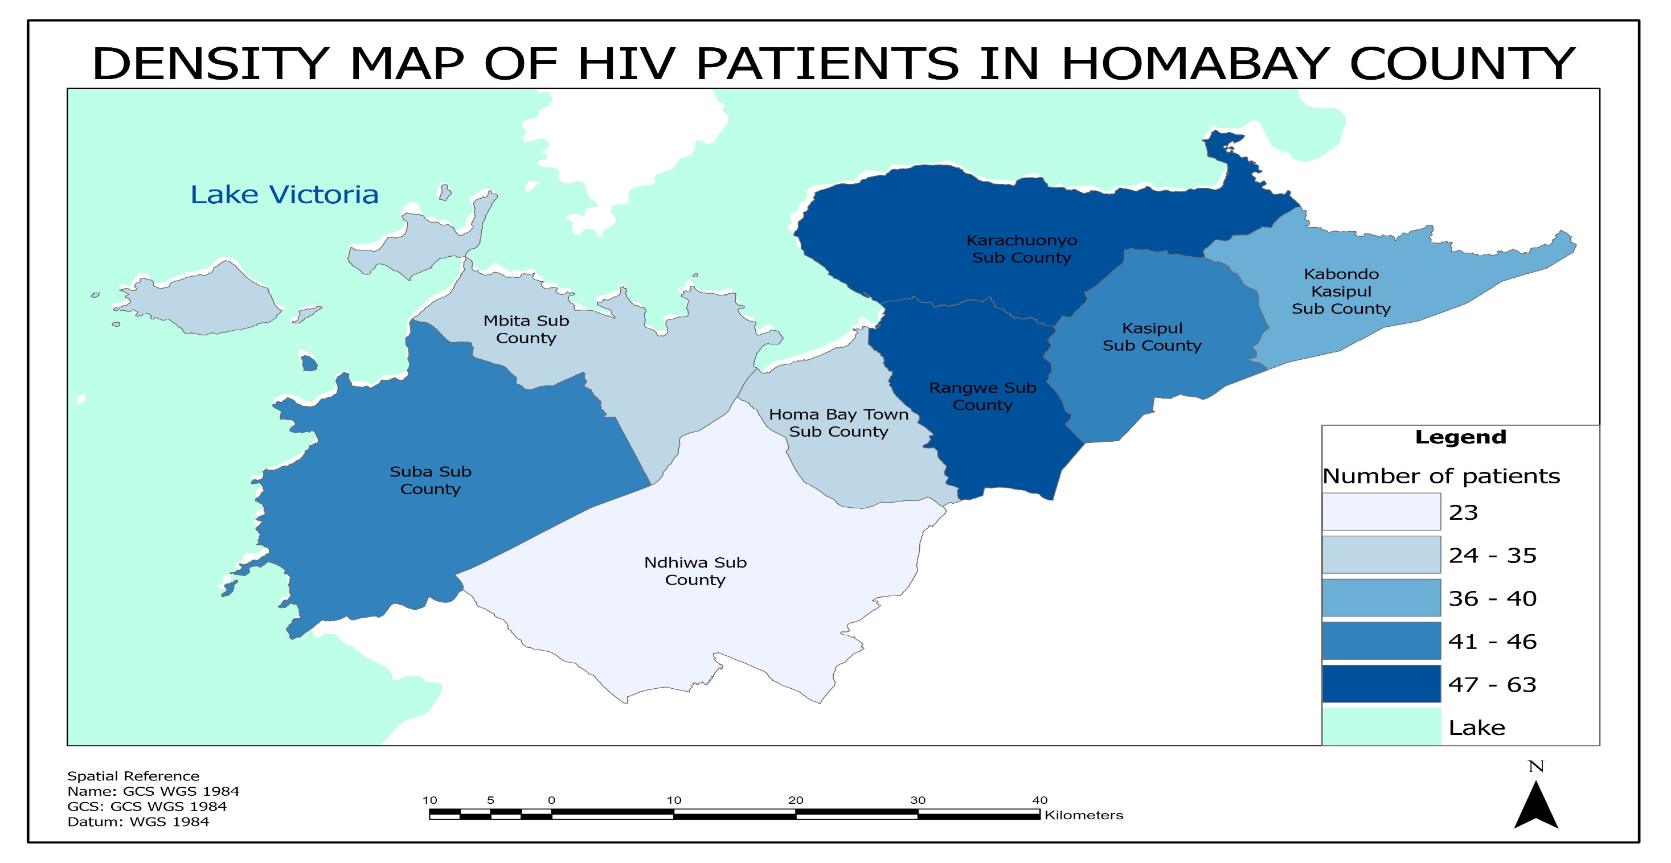

Slide 18
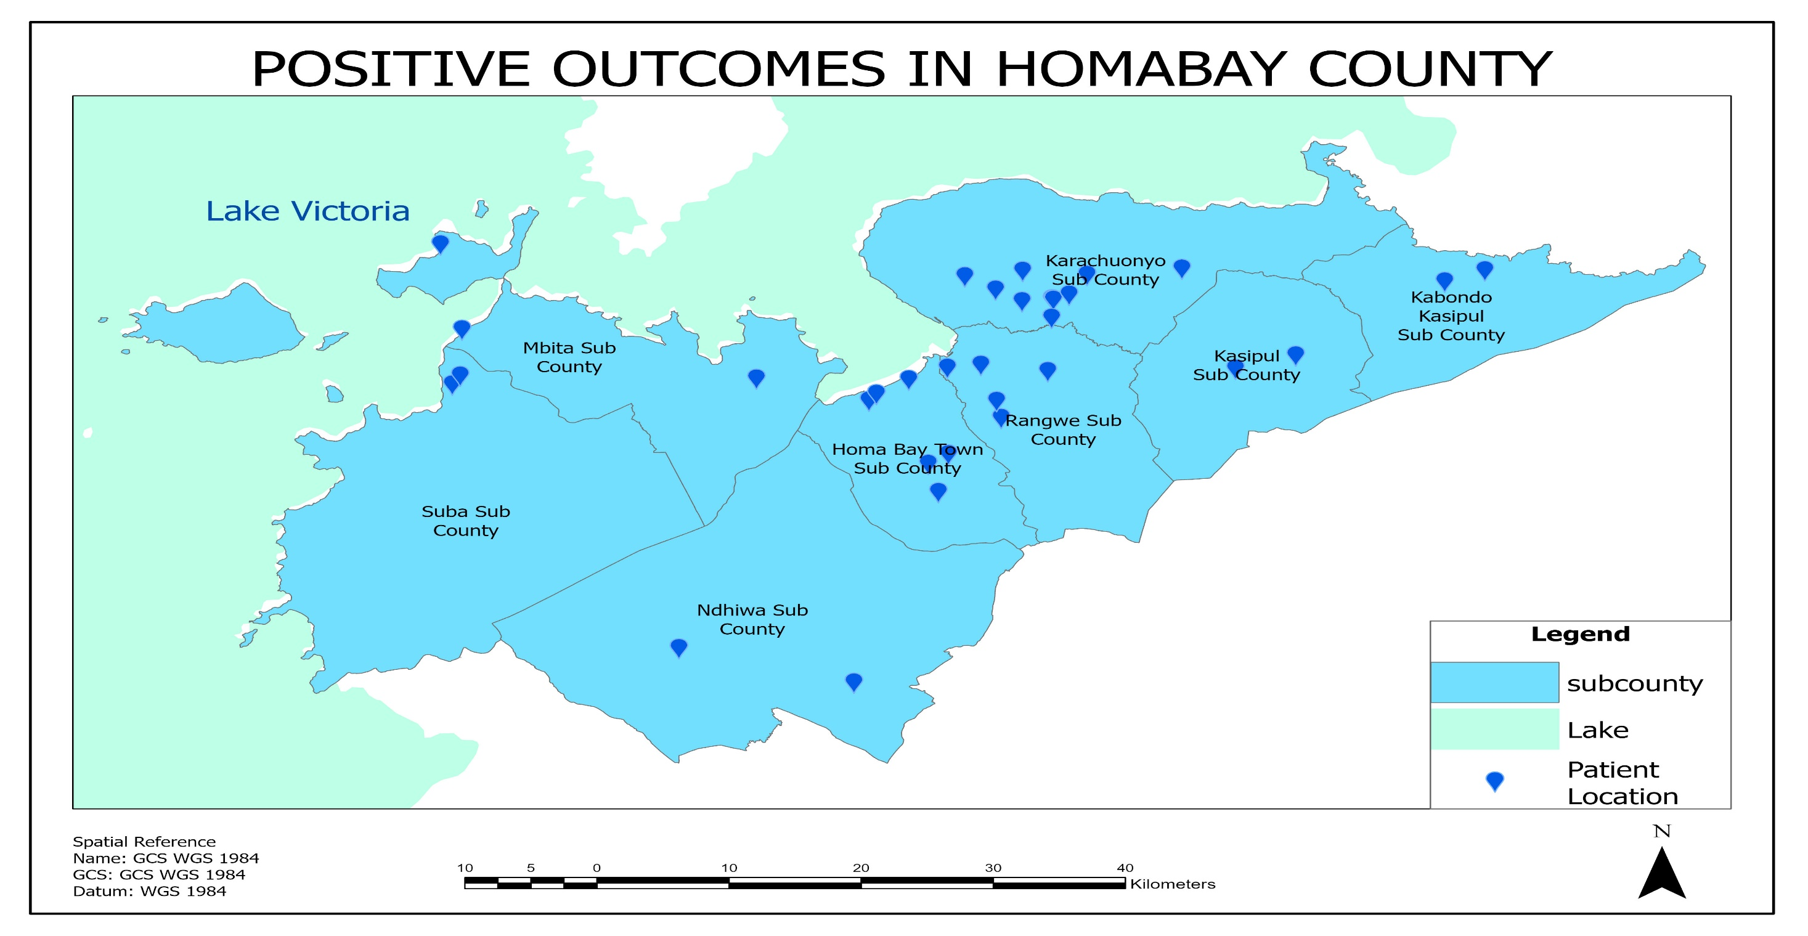

Slide 19
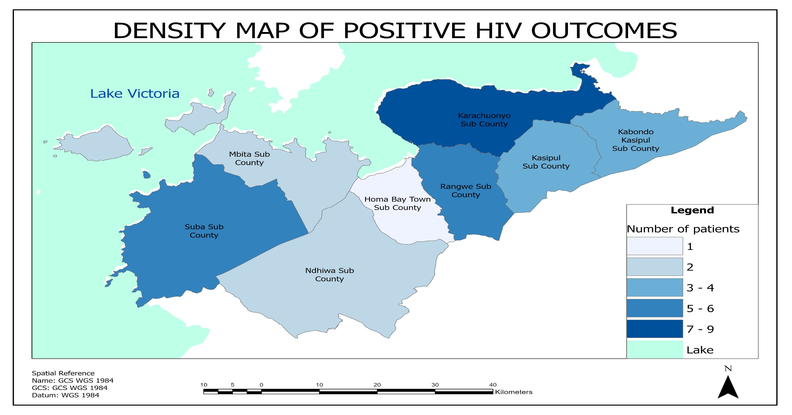

Slide 20
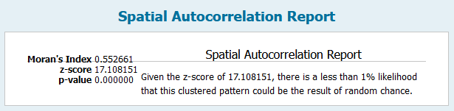

Slide 21


Slide 22
Discussion
The spatial autocorrelation analysis indicates a Moran's index value of 0.552661, a z-score of 17.108151, and a very small p-value.
These values suggest a strong positive spatial autocorrelation in the data, meaning that nearby observations are more similar to each other than would be expected by random chance.
This finding is statistically significant and indicates a clustered pattern in the data, highlighting the presence of spatial dependency.
The expected index of -0.002994 and variance of 0.001055 further support the presence of non-random spatial dependency in the dataset.
Overall, these results indicate a clustered pattern in the data, where nearby observations are more similar to each other than expected, highlighting the need for further exploration in spatial data analysis.

Slide 23
Recommendations
Based on the discussion, participants proposed several recommendations to enhance PMTCT services, increase male involvement, promote exclusive breastfeeding, and create a more supportive environment for HIV-positive mothers in the community.
These recommendations included targeted awareness campaigns, community sensitization programs, capacity building for healthcare providers, and the involvement of community leaders in advocating for PMTCT services.

Slide 24
Based on the spatial data analysis findings that vertical HIV transmission is higher in major towns, near the lake, and along major highways in Homa-Bay County, there are several recommendations that could be considered to address this issue:
Targeted Interventions
Community Outreach Programs
Provision of Prenatal Care
Capacity Building for Healthcare Providers
Integrated Services
Monitoring and Evaluation By implementing these recommendations, stakeholders can work towards reducing vertical HIV transmission in Homa-Bay County, particularly in areas where spatial data analysis indicates higher transmission rates.

Slide 25
References
REFERENCES
AVERT. An international AIDS Charity. Avert.org Worldwide HIV/AIDS epidemic statistics, 2005, http://www.avert.org/worlstatinfo.htm.
Becquet, M. Marston, F. Dabis, L. H. Moulton, G. Gray, et al., “Children Who Acquire HIV Infection Perinatally Are at Higher Risk of Early Death than Those Acquiring HIV through Breastmilk: A Meta-Analysis,” PLoS One, Vol. 7, No. 2, 2012, p. e28510.
Becquet, R., Bequet, L., Ekouevi, D. K., Viho, I., Sakarovitch, C., Fassinou, P., ... & ANRS 1201/1202 Ditrame Plus Study Group. (2007). Two-year morbidity–mortality and alternatives to prolonged breast-feeding among children born to HIV-infected mothers in Côte d'Ivoire. PLoS medicine, 4(1), e17.
Bhutta ZA, Ahmed T, Black RE, et al. What works? Interventions for maternal and child under nutrition and survival. Lancet. Feb 2 2008; 371(9610):417-440.
Bomsel M, Alfsen A. Entry of viruses through the epithelial barrier: Pathogenic trickery. Nat Rev Mol Cell Biol. 2003; 4(1):57–68. doi: 10.1038/Nrm1005 PMID: ISI:000180170900016.
Bomsel M, Heyman M, Hocini H, Lagaye S, Belec L, Dupont C, et al. Intracellular neutralization of HIV transcytosis across tight epithelial barriers by anti-HIV envelope protein dIgA or IgM. Immunity. (2008); 9 (2):277–87. Epub 1998/09/05. PMID: 9729048.
Becquet, R., Marston, M., Dabis, F., Moulton, L. H., Gray, G., Coovadia, H. M., ... & Kilewo, C. (2012). Children who acquire HIV infection perinatally are at higher risk of early death than those acquiring infection through breastmilk: a meta-analysis. PloS one, 7(2), e28510.
Berhan, Z., Abebe, F., Gedefaw, M., Tesfa, M., Assefa, M., & Tafere, Y. (2014). Risk of HIV and associated factors among infants born to HIV positive women in Amhara region, Ethiopia: a facility based retrospective study. BMC research notes, 7(1), 876.
Coutsoudis A, Pillay A, Kuhn L , Spooner E, Tsai EW, Coovadia H. Methods of feeding and transmission of HIV-1 from mothers to children by 15 months of age: prospective cohort study from Durban, South Africa. AIDS. 2001;115:379- 387.
Coutsoudis A, Pillay A, Kuhn L , Spooner E, Tsai EW, Coovadia H. Methods of feeding and transmission of HIV-1 from mothers to children by 15 months of age: prospective cohort study from Durban, South Africa. AIDS. 2009;115:379- 387.
Cournil A, De Vincenzi I, Gaillard P, et al.; Kesho Bora Study Group. Relationship between mortality and feeding modality among children born to HIV-infected mothers in a research setting: the Kesho Bora study. AIDS. 2013;27:1621–1630.
C King, C., R Ellington, S., & P Kourtis, A. (2013). The role of co-infections in mother-to-child transmission of HIV. Current HIV research, 11(1), 10-23.
Chi, B. H., Mutale, W., Lembalemba, M. K., Bolton-Moore, C., Stringer, J. S. A., Reid, S. E., ... & Chintu, N. T. (2017). Association of HIV antigen positivity with carriage duration in untreated infants and children older than 18 months: implications for diagnosis in the era of antiretroviral therapy scale-up. The Pediatric infectious disease journal, 36(9), 872-876.CSA, ICF International: Ethiopia Demographic and Health Survey (2011), Addis Ababa, Ethiopia and Calverton, Maryland, USA: Central Statistical Agency and ICF International.
Coovadia HM, Rollins NC, Bland RM, Little K, Coutsoudis A, Bennish ML. Mother-to-child transmission of HIV-1 infection during exclusive breastfeeding in the first 6 months of life: an intervention cohort study. Lancet. 2009;369(9567):1107-16. Epub 2010/04/03.
Creek TL, Sherman GG, Nkengasong J, Lu L, Finkbeiner T, Fowler MG, et al.
Infant human immunodeficiency virus diagnosis in resource-limited settings:
issues, technologies, and country experiences. Am J Obstet Gynecol. 2007;
197(3 Suppl):S64–71.
Cournil A, De Vincenzi I, Gaillard P, et al.; Kesho Bora Study Group. Relationship between mortality and feeding modality among children born to HIV-infected mothers in a research setting: the Kesho Bora study. AIDS. (2013); 27:1621–1630.
Coovadia HM, Rollins NC, Bland RM, et al. Mother-to-child transmission of HIV-1 infection during exclusive breastfeeding in the first 6 months of life: an intervention cohort study. Lancet. 2007;369:1107–1116.
C. Diaz, C. Hanson, E. R. Cooper, J. S. Read, J. Watson,H. A. Mendez, J. Pitt, K. Rich, V. Smeriglio and J. F. Lew, “Disease Progression in a Cohort of Infants with Vertically Acquired HIV Infection Observed from Birth: The Women and Infants Transmission Study (WITS),” Journal of Acquired Immune Deficiency Syndromes and Human Retrovirology, Vol. 18, No. 3, 1998, pp. 221-228. doi:10.1097/00042560-199807010-00004
Creek TL, Sherman GG, Nkengasong J, Lu L, Finkbeiner T, Fowler MG, et al.Infant human immunodeficiency virus diagnosis in resource-limited settings: issues, technologies, and country experiences. Am J Obstet Gynecol. 2007; 197(3 Suppl):S64–71.

Slide 26
Acknowledgements
I would like to express my sincere gratitude to the following individuals and organizations for their invaluable contribution and support throughout the completion of this study.
1. Professor Simon Karanja
Jomo Kenyatta University of Agriculture & Technology
2. Late Dr. Peter Wanzala
Institute of Tropical Medicine and Infectious Diseases (ITROMID)
3.Kemri Graduate School

